Slide 1
Smart Newspaper
Team ID : 4
Team Members:
Sai Kumar
Sravya Para
Sree Prathyusha Nomula
Sasleen Reza Shaik

Slide 2
Increment 1: Home page and use case case specification
Introduction
Our project involves building User Interface for Augmented Reality using Unity and Vuforia for mobile devices in order to provide a captivating feature in newspapers. This project creates a bridge between physical and digital worlds.

Slide 3
Project Goal and Objectives :
The Augmented Reality is an interesting trait in newspapers which takes readers beyond the printed page that enables people to see a video which is apparently located on a page of a newspaper. All this AR in a newspaper works through image recognition.
This technology of the digital content adds value to the printed article. Integrating Augmented Reality in to our project expands stories beyond the inches of screen, by digitally adding objects in to our space at real scale.
When AR is used with the newspaper, a photo in that particular article would be scanned with the camera of a mobile device, then that software identifies the photo and displays the related digital content in that mobile device.

Slide 4
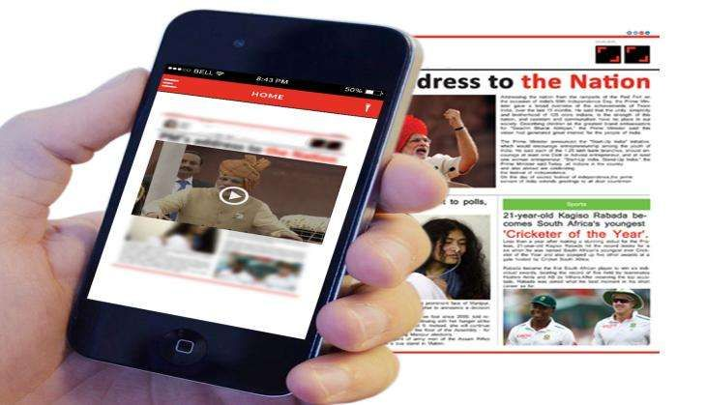

Slide 5
Thank You!

